Slide 1
Computer Architecture
Dr. Charles R. Severance
www.ca4e.com
online.dr-chuck.com

Slide 2
Outline
What is Computer Architecture
What is a Central Processing Unit (CPU)
Start with gates - AND / OR / NOT / XOR …
Adding numbers with gates – half and full adders
Number representation – Base 2 and Base 10 (hexadecimal)
Storing data with gates – Latches and Flip-Flops
Speed / Delay / Clocks
Programming with gates – machine code (0's and 1's)
Inside of a CPU

Slide 3
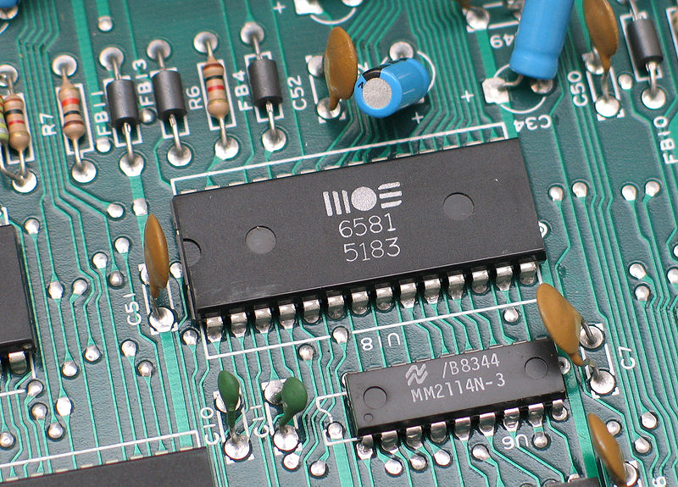
Computer Architecture
Within the computer data is moved using electric wires
Each wire generally has a voltage that is either a "0" or "1"
Wires connect components like the CPU, Memory, or other devices
A sound chip from a 1980's
Commodore 64 connected to the
motherboard
https://en.wikipedia.org/wiki/Printed_circuit_board

Slide 4

What
Next?
Generic
Computer
Software
Input
and Output
Devices
Central
Processing
Unit
Secondary
Memory
Main
Memory
From: Python for Everybody (www.py4e.com)

Slide 5
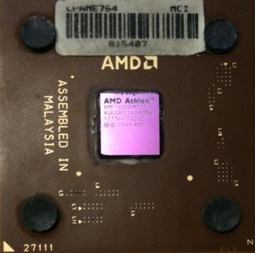
Definitions
What
Next?
Central Processing Unit: Runs the Program - The CPU is always wondering “what to do next”. Not the brains exactly - very dumb but very very fast
Input Devices: Keyboard, Mouse, Touch Screen
Output Devices: Screen, Speakers, Printer, DVD Burner
Main Memory: Fast small temporary storage - lost on reboot - aka RAM
Secondary Memory: Slower large permanent storage - lasts until deleted - disk drive / memory stick

Slide 6
What
Next?
Generic
Computer
Software
Input
and Output
Devices
Central
Processing
Unit
Secondary
Memory
if x< 3: print
Main
Memory
From: Python for Everybody (www.py4e.com)
Notes:
This slide is a block diagram of a computer showing a central processing unit connected to main memory. Software is loaded into the main memory. The software can also interact with input / output devices and secondary memory for long-term storage.

Slide 7
What
Next?
Generic
Computer
Software
Input
and Output
Devices
Central
Processing
Unit
Secondary
Memory
01001001
00111001
Main
Memory
Machine
Language
Notes:
This slide is a block diagram of a computer showing a central processing unit connected to main memory. Software is loaded into the main memory. The software can also interact with input / output devices and secondary memory for long-term storage.

Slide 8
Building Microprocessors

Slide 9

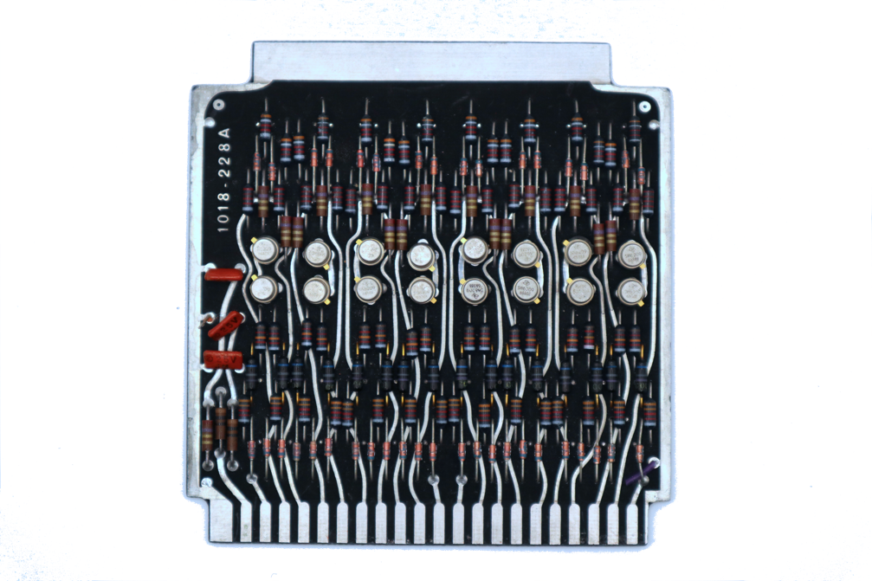
Very Large Scale Integration
We went from 16 transistors on a board 4 inches on a side to billions of transistors in a chip 0.5 inches on a side

Slide 10
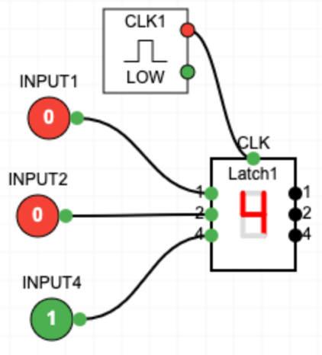
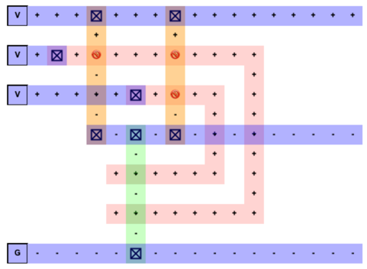
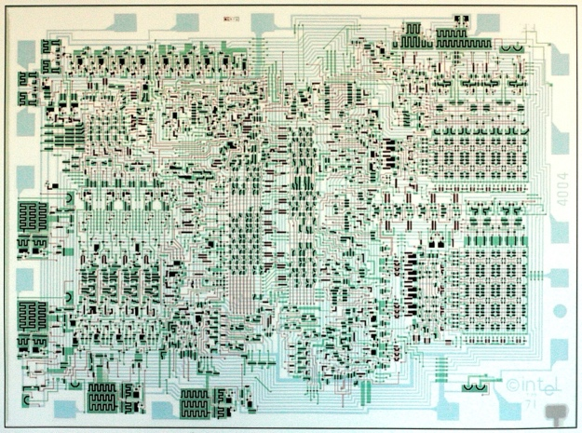
CPU Design Process
We start with gates and build reusable components and then combine those components to implement programmable digital logic
Software translates our abstract design into transistors and then creates an optimal layout for our chip
Photo lithography is then used to build the chip

Slide 11
Adding numbers with gates
Gates are now our low-level building blocks – we can combine them to solve problems

Slide 12
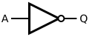
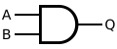
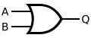
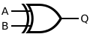
Classic Mathematical Logic Gates
Not
And
Or
Exclusive Or
A | B | Q
0 | 0 | 0
0 | 1 | 0
1 | 0 | 0
1 | 1 | 1
A | B | Q
0 | 0 | 0
0 | 1 | 1
1 | 0 | 1
1 | 1 | 1
A | B | Q
0 | 0 | 0
0 | 1 | 1
1 | 0 | 1
1 | 1 | 0
A | Q
0 | 1
1 | 0

Slide 13
Representing Numbers with 0's and 1's
If we are going to do significant computations, we will need a way to represent numbers as electrical values
"Normal" numbers are Base-10
We know the place values of Base-10 numbers
To manipulate numbers with gates, we use Base-2 numbers
Base-10
123₁₀ = 1 x 10² + 2 x 10¹ + 3 * 10⁰
= 1 x 100 + 2 * 10 + 3 * 1 = 123₁₀
Base-2
110₂ = 1 * 2² + 1 * 2¹ + 0*2⁰ =
= 4 + 2 + 0 = 6₁₀

Slide 14
Keep it simple for now
Base–2 to Base-10 for numbers less than 8
A.k.a. 3-bit numbers
Base-10 | Base-2
0 | 0
1 | 1
2 | 10
3 | 11
4 | 100
5 | 101
6 | 110
7 | 111
4s 2s 1s
1 1 0 = 6

Slide 15
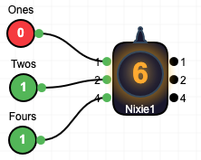
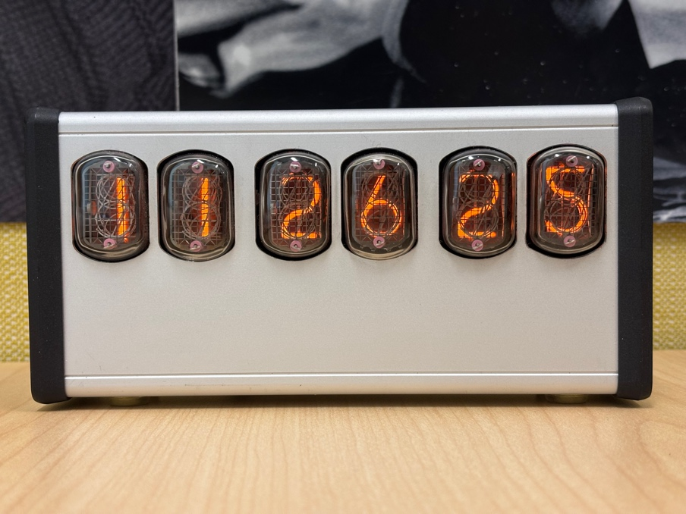
Nixie Tubes – Binary to Decimal Display
4 2 1
1 1 0 = 6
https://en.wikipedia.org/wiki/Nixie_tube

Slide 16
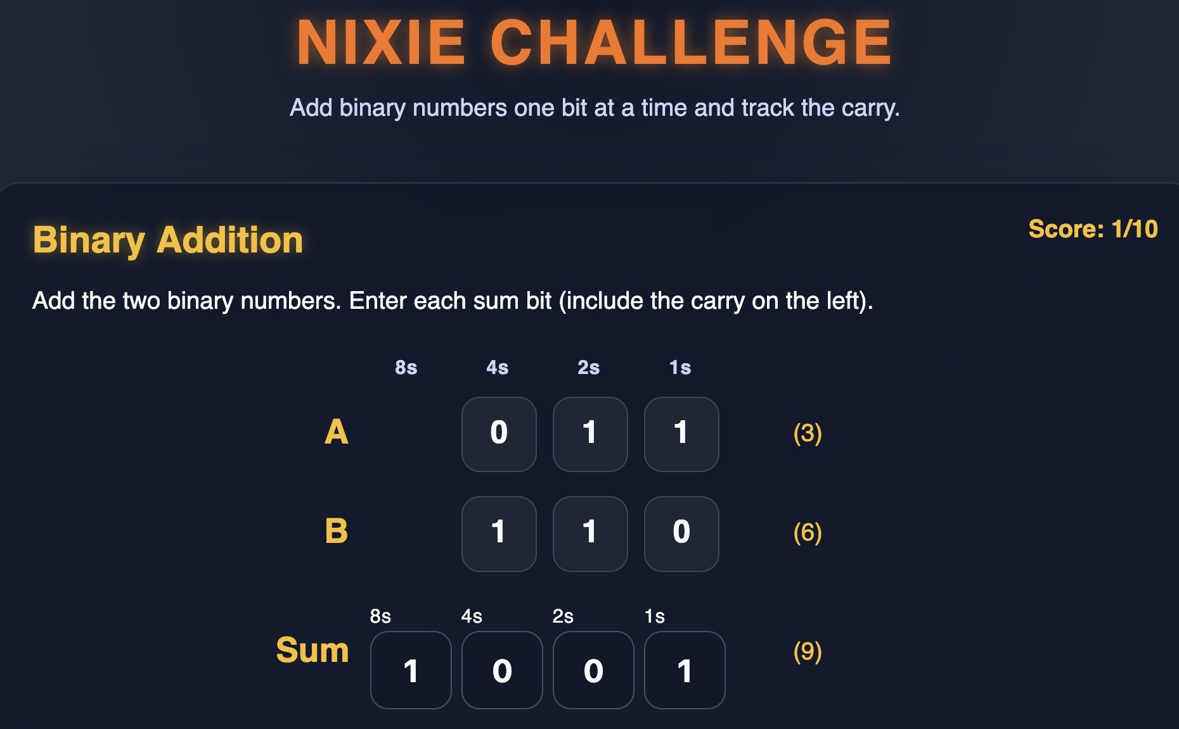
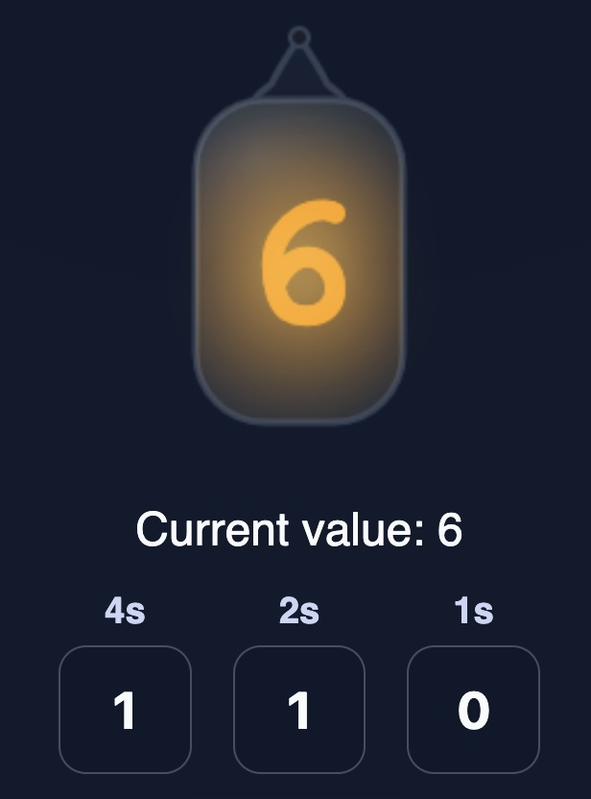
https://www.ca4e.com/tools/nixie/

Slide 17
Base-2 Math
1 (1)
+ 1 (1)
1 0 (2)
1 0 (2)
+ 1 0 (2)
1 0 0 (4)
1 0 0 (4)
+ 1 0 0 (4)
1 0 0 0 (8)
1 1 (3)
+ 1 (1)
1 0 0 (4)
1 1 (3)
+ 1 0 (2)
1 0 1 (5)
1 1 1 (7)
+ 1 (1)
1 0 0 0 (8)

Slide 18
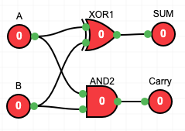
Half Adder
Compute the sum of two base-2 digits and produce a sum and carry.
A | B | Sum | Carry
0 | 0 | 0 | 0
0 | 1 | 1 | 0
1 | 0 | 1 | 0
1 | 1 | 0 | 1
A
HALF
Adder
SUM
B
Carry

Slide 19
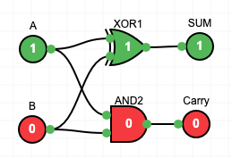
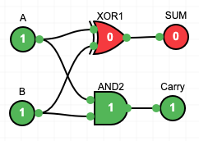
Half Adder
Compute the sum of two base-2 digits and produce a sum and carry.
A | B | Sum | Carry
0 | 0 | 0 | 0
0 | 1 | 1 | 0
1 | 0 | 1 | 0
1 | 1 | 0 | 1
A
HALF
Adder
SUM
B
Carry

Slide 20
Full Adder
Carry in | A | B | Sum | Carry Out
0 | 0 | 0 | 0 | 0
0 | 0 | 1 | 1 | 0
0 | 1 | 0 | 1 | 0
0 | 1 | 1 | 0 | 1
1 | 0 | 0 | 1 | 0
1 | 0 | 1 | 0 | 0
1 | 1 | 0 | 0 | 1
1 | 1 | 1 | 1 | 1
Adds three 0/1 numbers for a sum/carry between 0 and 3
Carry In
FULL
Adder
SUM
1 (CIN)
1 (A)
+ 1 (B)
1 1 (3)
A
Carry out
B

Slide 21
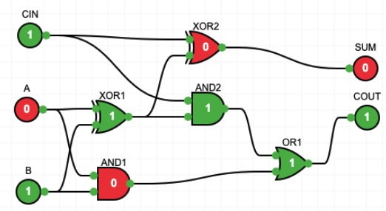
Full Adder
Adds three 0/1 numbers for a sum/carry between 0 and 3
1 (CIN)
0 (A)
+ 1 (B)
1 0 (2)
Notes:
A diagram of a full adder circuit with inputs A and B with a Carry-In of CIN. The output is single bit SUM and a single but Carry Out. The circuit consisted of two half adders connected and an OR gate to compute the carry out when all the inputs are 1.

Slide 22
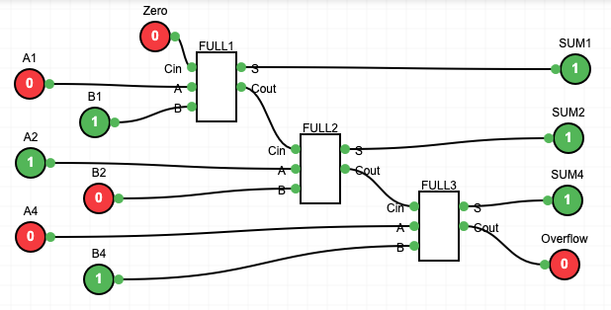
Chaining full adders
0 1 0 (2)
+ 1 0 1 (5)
1 1 1 (7)

Slide 23
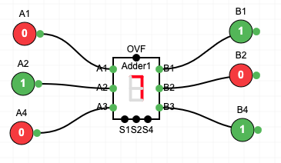
Three Bit Adder Component
Once we know how to make something, add a component to our design system
0 1 0 (2)
+ 1 0 1 (5)
1 1 1 (7)

Slide 24
Storing data with gates
Latches and Flip-Flops

Slide 25
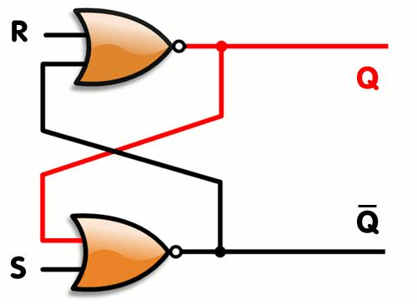
Storing Data Using Feedback Loops
The simplest latch is a "Set-Reset" latch using two NOR gates
The output of each NOR gate is connected to the one of the inputs of the other NOR gate
A | B | NOR
0 | 0 | 1
0 | 1 | 0
1 | 0 | 0
1 | 1 | 0
S | R | Q
0 | 0 | Maintain
0 | 1 | 0
1 | 0 | 1
1 | 1 | ???
https://en.wikipedia.org/wiki/Flip-flop_%28electronics%29

Slide 26
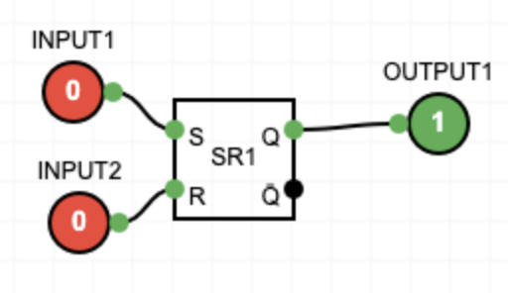
SR Flip-Flop / Latch
S | R | Q
0 | 0 | Maintain
0 | 1 | 0
1 | 0 | 1
1 | 1 | ???
When S and R are zero, the latch maintains its value
When S=0 and R=1 the internal value becomes 0
When S=1 and R=0 the internal value becomes 0
Setting both to 1 means output is undefined

Slide 27
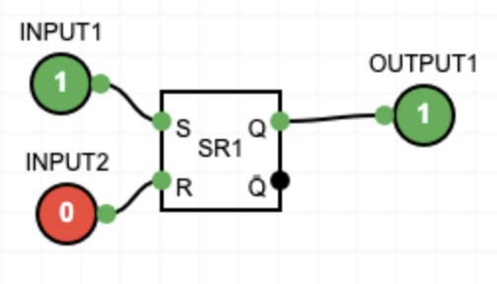
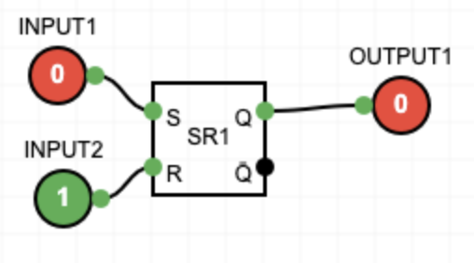
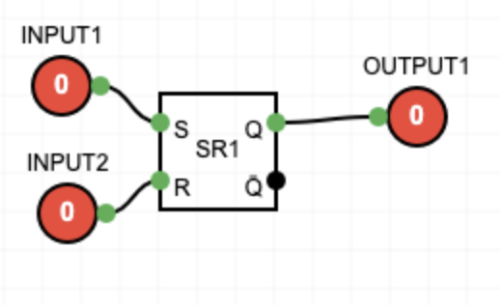
SR Flip-Flop / Latch
Set / Reset
Stored Value
S | R | Q
0 | 0 | Maintain
0 | 1 | 0
1 | 0 | 1
1 | 1 | ???

Slide 28
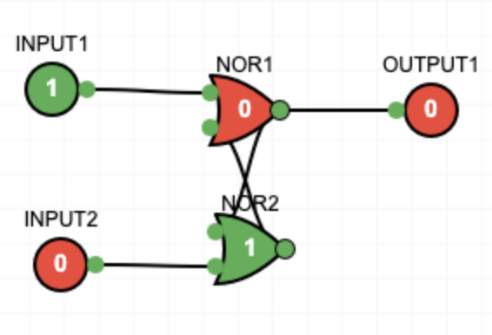
My Simulators Can't Build an SR Latch :(
My Digital Logic Builder does not handle feedback loops so you can't build a SR latch from two NOR gates (unless I fix it)
SR Circuit Fails ☹
SR Component Works

Slide 29
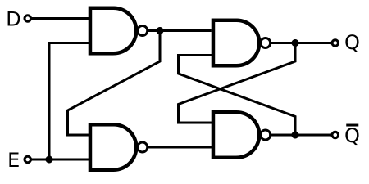
Gated D Latch
C | D | Q
0 | 0 | Maintain
0 | 1 | Maintain
1 | 0 | 0
1 | 1 | 1
The Gated D Latch has a D (data) and a C (clock) inputs.
If C is zero, D is ignored, and the output is the most recent stored value
If C is 1, D is copied into the internal state
C

Slide 30
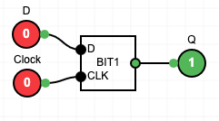
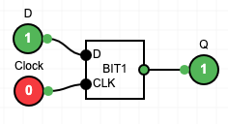
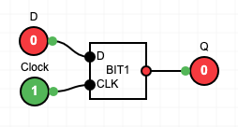
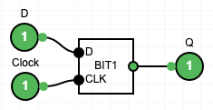
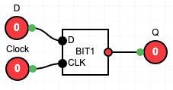
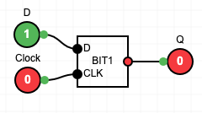
Gated D Latch
Ignore D
Store 0
Clock to 0
Clock to 0
Store 1
Ignore D

Slide 31
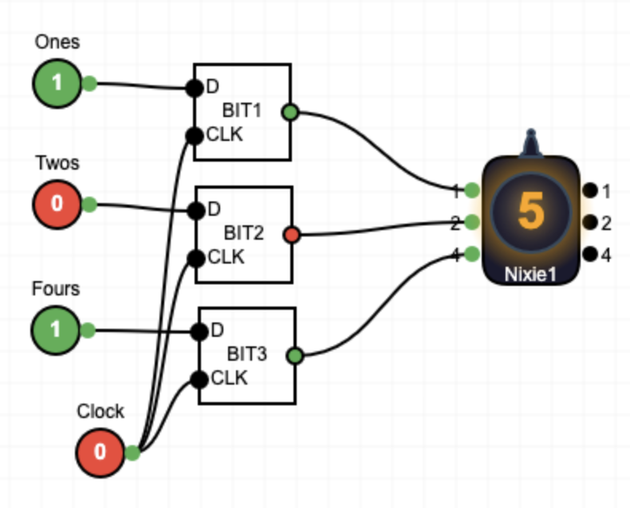
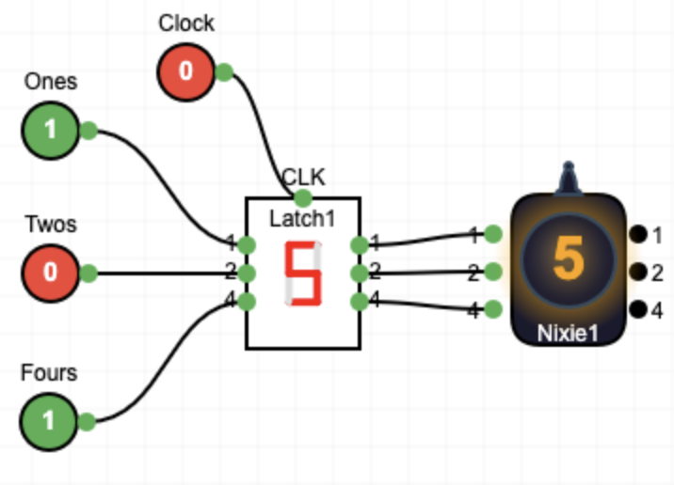
Stack D Latches to Make a 3-bit Register

Slide 32
Speed / Delay / Clocks
Latches and Flip-Flops

Slide 33
Delay
The "longer" a circuit is, the longer it takes for the outputs to "settle" to their final values
Full Adder
Notes:
This is a full adder laid out in the gates tool. It has three XOR gates and two AND gates. The point is that it has some “distance” from left to right - which translates to a slight delay form when the inputs are presented on the right to when you can reliably expect that the outputs are stable on the right outputs.

Slide 34
Circuits can get quite long
CI
S
A
CO
B
CI
S
32 bit adder
A
CO
B
CI
S
A
CO
4 bit adder
B
64 bit adder?
64 bit multiplier?
CI
S
A
CO
B

Slide 35
64 Bit
Adder
Once a circuit is designed and laid out, circuit simulators can compute the time it takes for signals to propagate through the circuit. We can not trust at the results to be accurate until sufficient time has passed.

Slide 36
Clock Rate
Once we compute the delay of the slowest element of the Arithmetic and Logic parts of the CPU (aka the ALU), we can determine the number of times per second we can reliably do computations.

Slide 37
What Determines Clock Rate?
The size of the chip (speed of light)
The number of transistors in the longest path within the ALU
The physical length of the longest path within the ALU (speed of light)
The speed at which each transistor switches between 0 and 1 (depends on the technology used to build the chip)
Chips are designed, redesigned, laid out, and simulated endlessly during development to produce the fastest clock rate

Slide 38
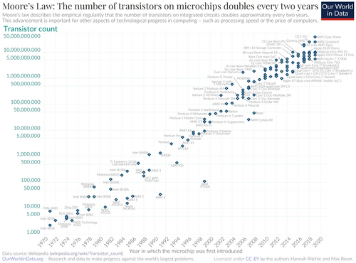
Moore's Law
Moore's law is the observation that the number of transistors in an integrated circuit (IC) doubles about every two years.
X-Axis 1970 - 2020
Y-Axis 1000 - 50 billion
https://en.wikipedia.org/wiki/Moore%27s_law

Slide 39
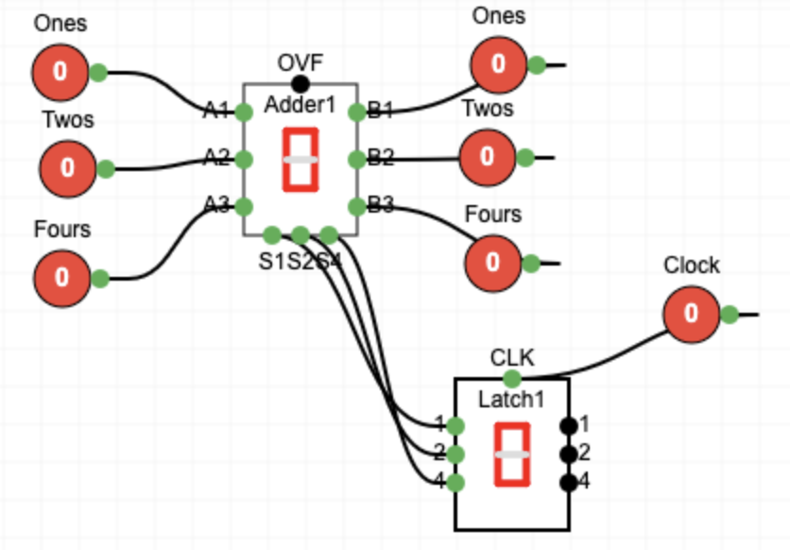
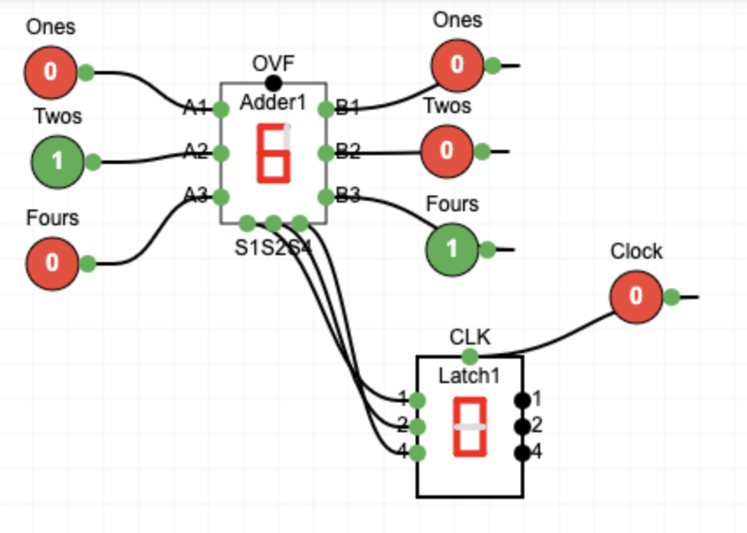
An Adder, Clock, and Register, Oh My!
The adder and its inputs is a "combinational circuit"
The latch is a "clocked circuit", ignoring its inputs while the clock is low, then "latching" the inputs in once the clock goes high
When the clock is low input changes are ignored

Slide 40
An Adder, Clock, and Register, Oh My!
At this point, we have changed the adder input values.
The adder is adding the values and producing the sum reacting to whatever we do with a small delay.
The latch is ignoring all changes of the sum values

Slide 41
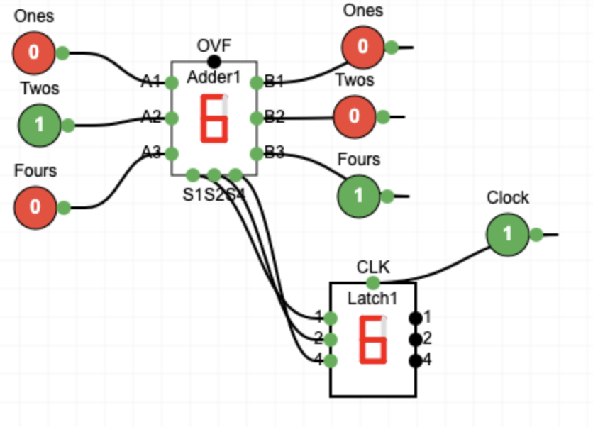
An Adder, Clock, and Register, Oh My!
Once the clock is set to 1, the sum values are "latched" into the latch's internal memory.
At this point if we change inputs the latch may or may not get new sum values depending on the delay of the adder

Slide 42
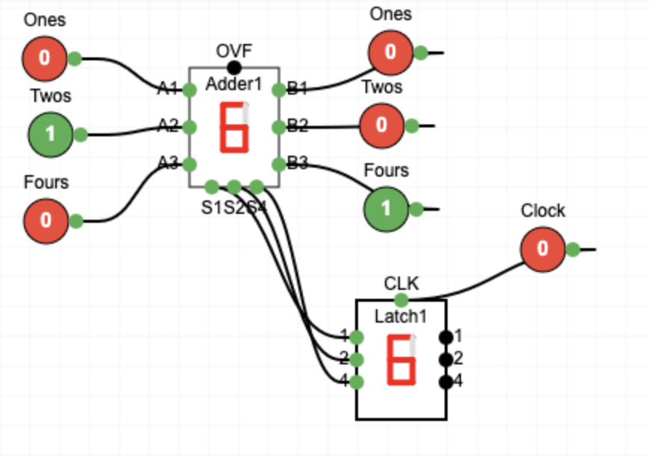
An Adder, Clock, and Register, Oh My!
So once we copy the sum inputs into the latch, the clock goes back down
We can once again change the adder inputs without affecting the latch since the clock is low.

Slide 43
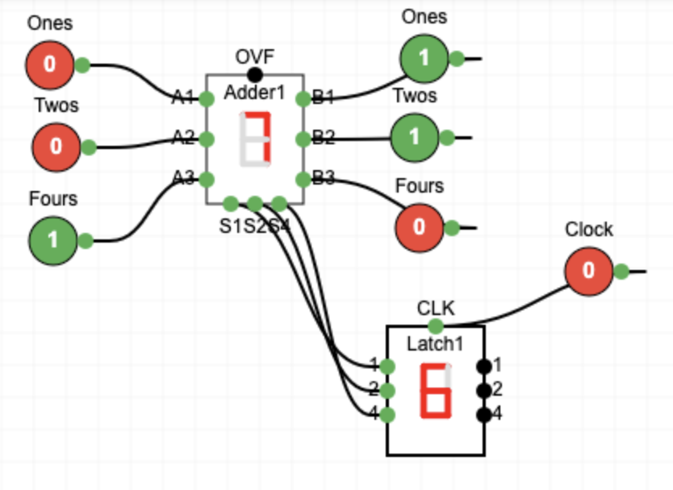
An Adder, Clock, and Register, Oh My!
As we change the inputs to the adder, its sum outputs change to 7 (with a short delay) but the latch retains its stored value of 6 since the clock is low.
If the clock goes high the 7 would be copied in as the new latch stored value

Slide 44
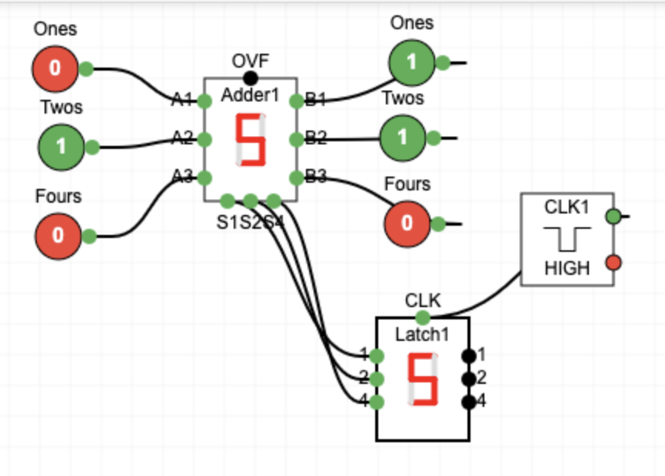
For a good time…
Replace the clock button with an automatic 1 hertz clock (toggles once per second)
Play with the adder inputs and watch as the clock causes them to be copied into the latch.
See how many inputs you can change in one second
You can start and stop the clock by clicking on it ☺

Slide 45
Counting using Gates

Slide 46
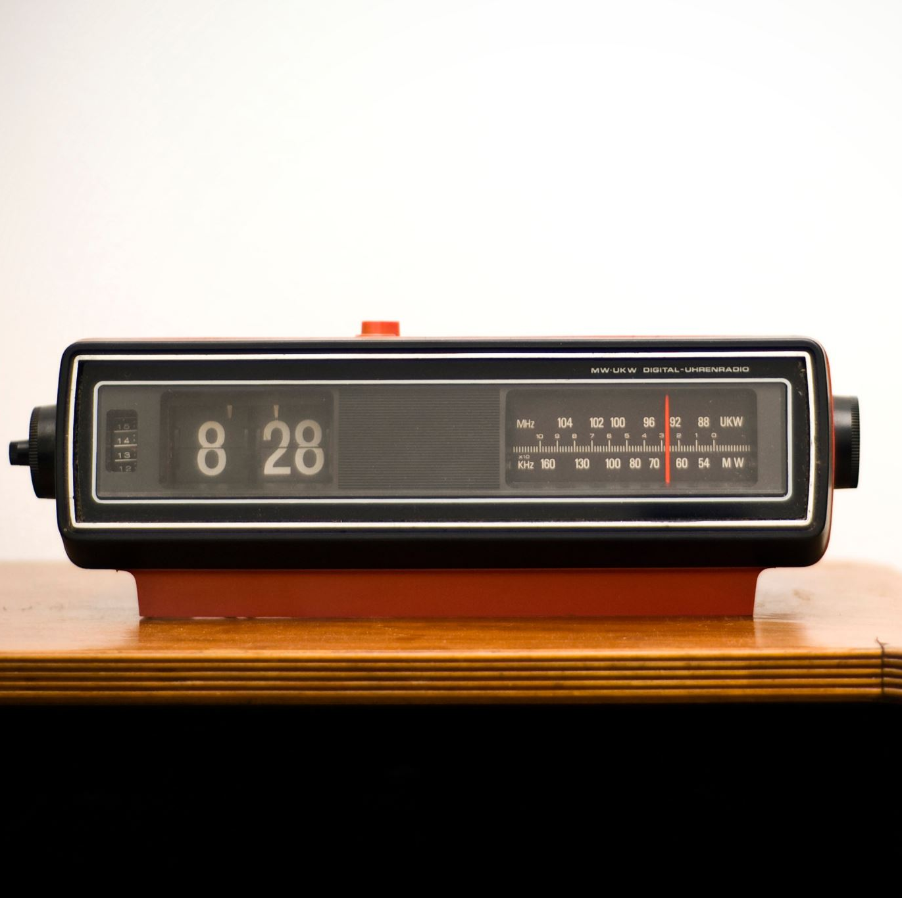
Let's make a counter
If we take an adder, clock, and register, we can make a counting unit by adding 1 to the register each clock cycle.

Slide 47
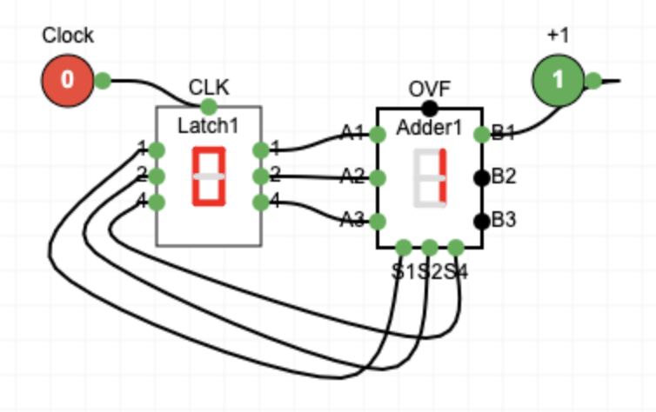
Let's make a counter
If we take an adder, clock, and register, we can make a counting unit by adding 1 to the register each clock cycle.
With the clock low and latch stored value of zero, the adder is continuously computing 0+1 but the latch is ignoring its inputs

Slide 48
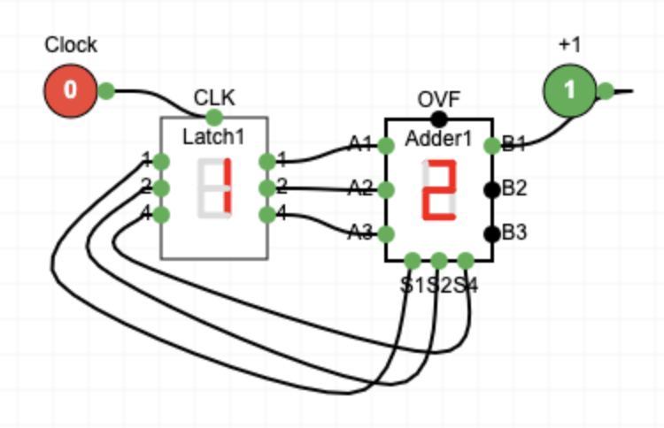
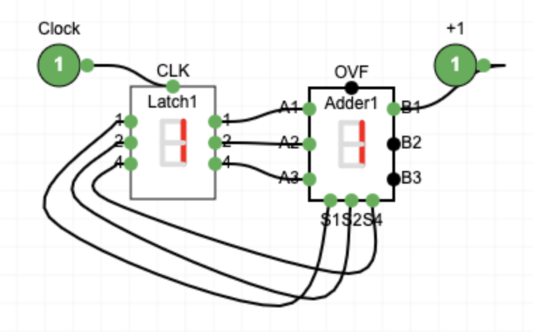
Let's make a counter
When the clock goes high, the latch stores its inputs, but does not copy the stored data to the latch output until the clock goes low
So, the adder is still computing 0+1 (i.e. not 1+1)

Slide 49
Let's make a counter
When the clock goes low, the stored latch data is presented to the adder which computes 1+1=2 (after a short delay)

Slide 50
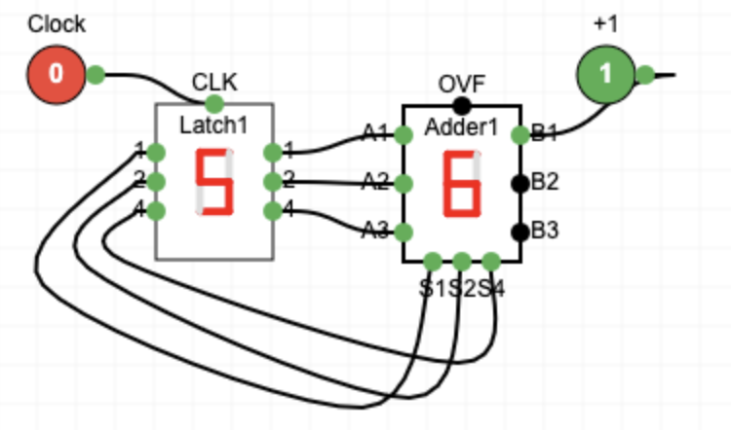
Let's make a counter
If you keep toggling the clock the counter will count up to 7, overflow and restart the count at 0 again

Slide 51
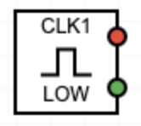
For a good time…
Replace the clock button with an automatic 1 hertz clock (toggles once per second)
You just made a simple seven-second clock!

Slide 52
Programming with gates
Machine code programming in (0's and 1's)

Slide 53
What
Next?
Generic
Computer
Software
Input
and Output
Devices
Central
Processing
Unit
Secondary
Memory
01001001
00111001
Main
Memory
Machine
Language
Notes:
This slide is a block diagram of a computer showing a central processing unit connected to main memory. Software is loaded into the main memory. The software can also interact with input / output devices and secondary memory for long-term storage.

Slide 54
Inside a CPU
CPU
Arithmetic / Logic Unit
Data
Registers
The ALU is circuits like adders
Registers are latches
Control logic and clock connect everything together
Instructions are taken from memory, decoded by the control logic which instructs the registers and ALU on what to do using wires, circuits and gates
Control Logic
Clock
Data
Instructions
Cache / Memory
https://en.wikipedia.org/wiki/Central_processing_unit

Slide 55
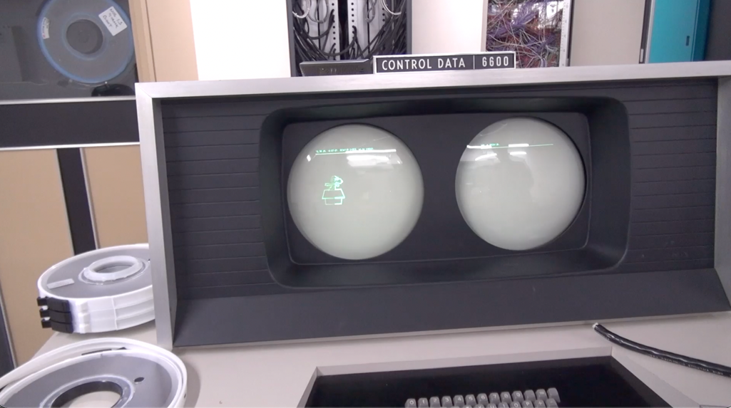
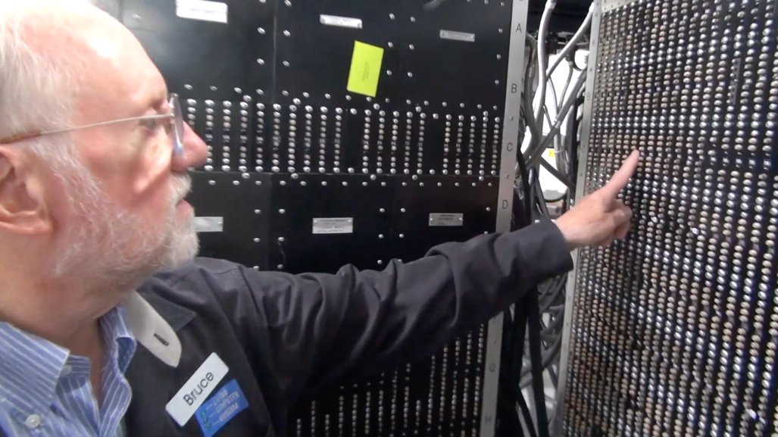
Foreshadowing..
Soon, we will design a simple CPU
CDC 8512 – Inspired by the Control Data Corporation 6500
It will have a complete architecture
It will have a completely defined machine language
We will write real programs in CDC 8512 machine code and run them in an emulator
https://en.wikipedia.org/wiki/CDC_6000_series#Central_processor

Slide 56
For now, we will build a simple CPU
One 3-bit latch
Two machine language instructions
0 – Clear the latch
1 – Add 1 to the latch
It will have a 1 Hz clock and be capable of executing one instruction per second
We will build this CPU and run it in our emulator

Slide 57

Start with our counter
A latch feeds its stored value into one operand of an adder (clock low)
We hard-code the other adder input to be 1
We have a clock to tell the latch when to copy its new input to its internal state (clock high)

Slide 58
Add control logic
Control
Logic
Have an instruction input
0 – Reset latch to zero
1 – Copy output of adder
The instruction is fed into three AND gates
The sum values also go into the AND gates
The output of the AND gates goes into the Latch

Slide 59
Instruction 0
When instruction is zero, the output of the three AND gates is zero and the latch stays zero (reset)

Slide 60

Instruction 1
When instruction is one, the sum values are passed to the latch inputs
And each clock rise/fall adds 1 to the latch value

Slide 62
What is missing?
The instructions are not being read from memory.
It is like there is a switch on the front of the computer and it chooses between the two instructions
We want a flexible sequence of many instructions executed one after another (a.k.a. Software)

Slide 63
Stored Sequences of Instructions

Slide 64
Fetch-Decode-Execute-Cycle
CPU
ALU
Data
Registers
Program Counter (PC) Register – Address of the next machine code instruction
Current Instruction Register (CIR)
The decoder looks at the bits of the CIR and using gates activates the correct ALU Element and register
The Clock tells the logic when to compute and when to copy results back to the register
PC
CIR
Decoder
Instructions
Cache / Memory
https://en.wikipedia.org/wiki/Binary_decoder

Slide 65
Machine Language Instructions
As part of the documentation for a CPU, we are given the bit patterns of the machine code for each of its instructions
There is usually a symbolic language that translates to machine language (assembler)
Assembly Language | Binary | Description
ZERO reg | 01000rrr | Set register to zero
CMPZ reg | 01001rrr | Compare register to zero
INC reg | 01010rrr | Increment register by 1
DEC reg | 01011rrr | Decrement register by 1

Slide 66
Foreshadowing..
Soon, we will design a simple CPU
CDC 8512 – Inspired by the Control Data Corporation 6500
It will have a complete architecture
It will have a completely defined machine language
We will write real programs in CDC 8512 machine code and run them in an emulator
https://en.wikipedia.org/wiki/CDC_6000_series#Central_processor

Slide 67


Enough foreshadowing …

Slide 68
Summary
In this lecture we started with simple gates like AND and OR
We built latches / registers for storage
We introduced the notion of a clock to wait until computation is complete
We talked about how clock rate has improved over time
We learned about the internals of a CPU – registers, arithmetic logic unit, program counter, and decoder logic
Up next: Designing and implementing a CPU architecture and its machine language

Slide 69
Acknowledgements / Contributions
These slides are Copyright 2025- Charles R. Severance (online.dr-chuck.com) as part of www.ca4e.com and made available under a Creative Commons Attribution 4.0 License. Please maintain this last slide in all copies of the document to comply with the attribution requirements of the license. If you make a change, feel free to add your name and organization to the list of contributors on this page as you republish the materials.
Initial Development: Charles Severance, University of Michigan School of Information
Insert new Contributors and Translators here including names and dates
Continue new Contributors and Translators here

